Slide 1

Oinos Fast Food & Fine dining
Made by: István Balla & Ádám Ákos Racskó

Slide 2
Introduction
Welcome to our presentation on our online ordering system/table booking for our restaurant.
Our goal is to make ordering and reservations easier and more convenient for customers and the work restaurant staff.

Slide 3
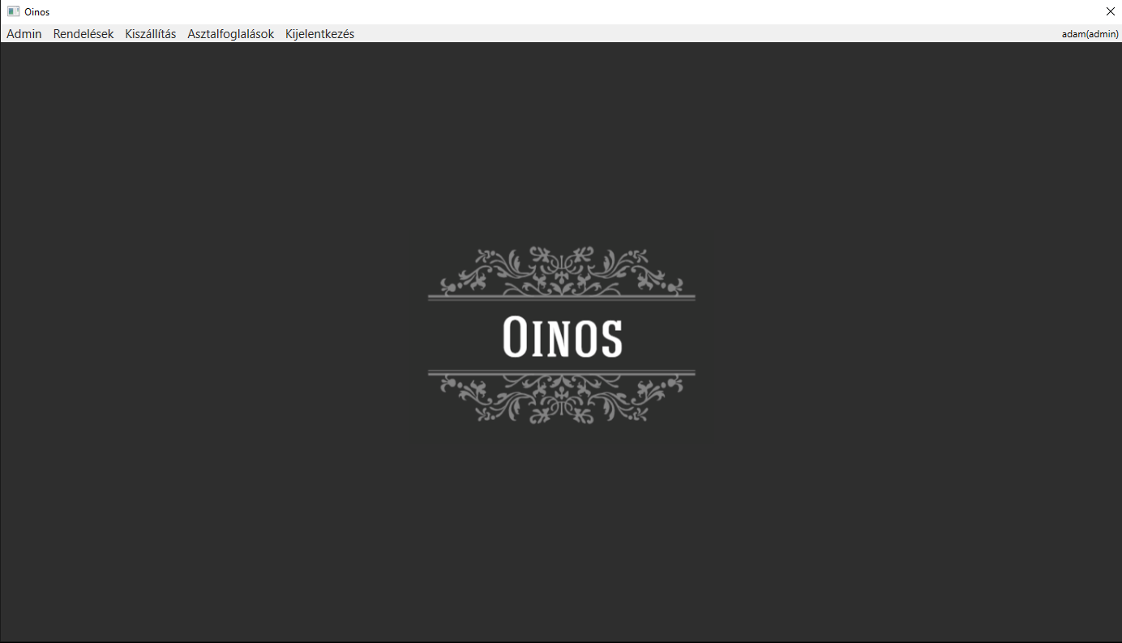
Management software
Our software is designed to create an efficient and streamlined ordering process for restaurants.
Depending on user privilege, a user can:
Update, delete, and create new users or menu items
Mark orders as finished
Mark orders as delivered
View reservations for today

Slide 4
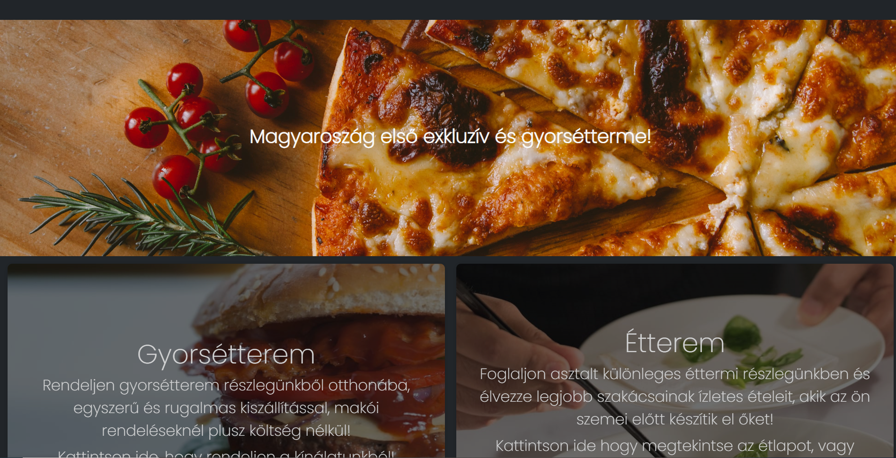
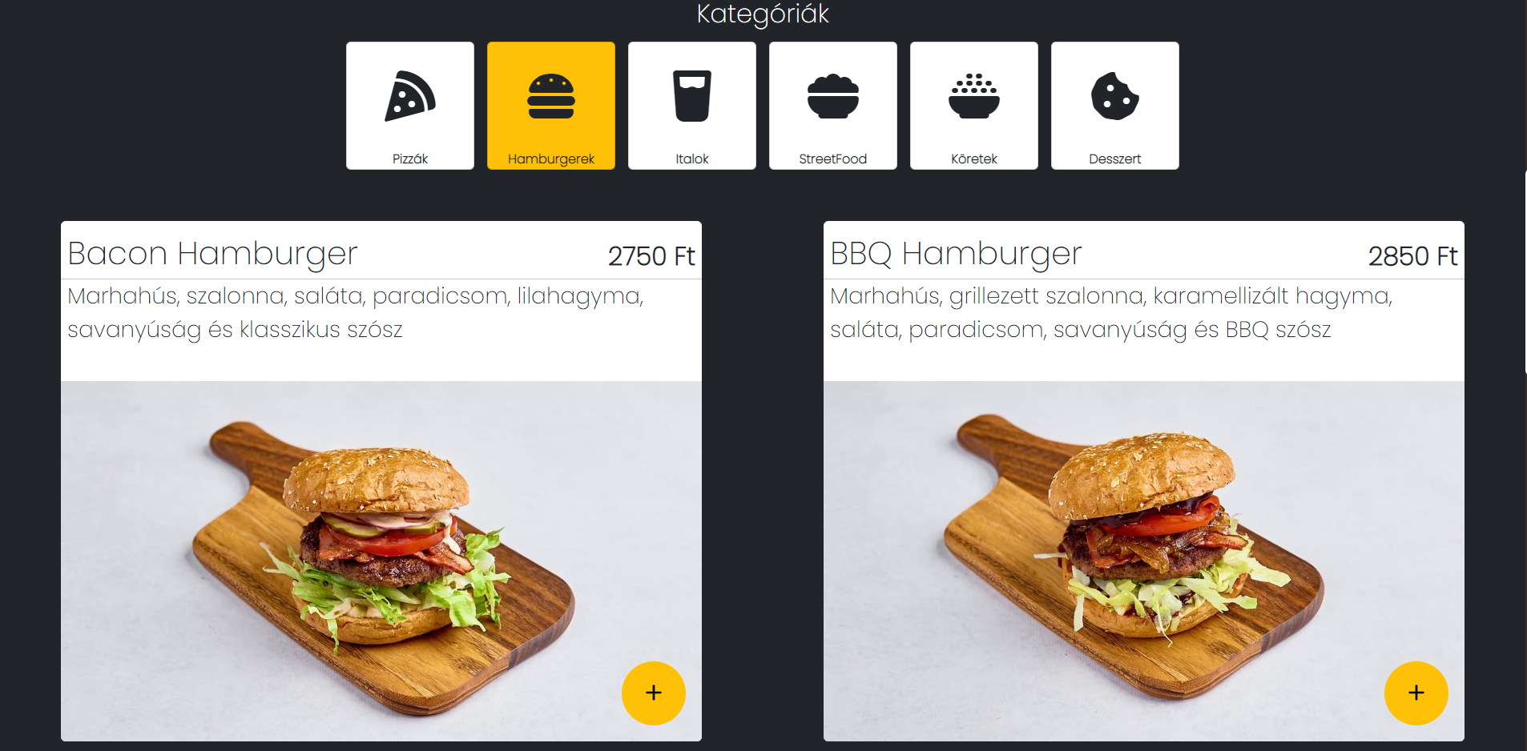
Website Design
Our restaurant website is designed to be visually appealing and easy to navigate for customers.
The layout is simple and intuitive, allowing customers to easily find what they're looking for.
The color scheme is warm and inviting, creating a welcoming atmosphere for customers.

Slide 5
Features
Our website includes a range of features to make the ordering and reservation process as convenient as possible for customers.
Customers can create an account to store their personal information, making it easier to place orders or make reservations in the future.
The menu is easy to navigate and includes both fast food and fine dining options.
The reservation system allows customers to reserve tables for the fine dining section of the restaurant.

Slide 6
Technical Implementation
Our project was a group effort that required collaboration and coordination to ensure that each aspect of the software/web was designed and implemented correctly.
We used Trello to organize tasks and deadlines, Figma for design mockups, Git for version control and Discord to communicate and coordinate with team members.
Our software incorporates an SQL database to store customer data and order history, and every other component in the database and we made sure to compress images and ensure that all icons and graphics were legally sourced.

Slide 7
Functionality
Customers can view menus, place orders, make reservations, and view their order history online.
They can create an account to store their personal information, making the ordering process more efficient.
Restaurant staff can access an admin panel to manage customer accounts and orders, update menus, and view reservation details.
Our website is designed to be responsive, and fast.

Slide 8
Future Development
In the future, we plan to add additional features to our software, such as the ability to schedule pickup times and track the exact delivery status.
We also hope to improve the user interface and make the ordering process even more streamlined and efficient.
With continued development and improvements, we believe that our website has the potential to revolutionize the restaurant industry and make ordering and reservations easier and more convenient for customers.

